Slide 1
Lecture 24
Electro-optic effect

Slide 2
Anharmonicity
The force acting upon the atom is in the lowest order approximation, where K is a constant
e-cloud
K
Solution: harmonic oscillation
K
That corresponds to the electron moving in the parabolic potential energy well
U(x)
This potential does not look physically meaningful and is actually just an approximation of a real potential valid for small x
0
x
The next order approximation is
The new equation of motion is
It contains only the odd order terms because potential has inversion symmetry U(x)=U(-x)
-U₀

Slide 3
Potential without inversion symmetry
The electron cloud is shifted
Electron sees different environments on the left and on the right
U(x)
The potential is asymmetric – cannot be represented by even order curve
0
x
The next order approximation
-U₀
The new equation of motion is

Slide 4
Impact of DC field
EDC
E(t)
What if we apply DC field
(under DC we actually mean low frequency relative to optical frequency, i.e. up to 1THz
It appears that impact should be different depending on sign of EDC
Let us solve equation of motion in the presence of DC and AC fields
We shall look for solution
(the third term is much smaller than the first two)
(higher order terms can be neglected)
Second harmonic term – omit it for now

Slide 5
Nonlinear susceptibility
Combine the terms of the same order and time dependence
Linear motion at optical frequency
DC shift (low frequency motion)
Total polarization at optical frequency
Linear or 1st order Susceptibility
Nonlinear 2nd order Susceptibility
Units: m/V

Slide 6
Estimate of the upper limit of χ⁽²⁾
Consider maximum possible nonlinearity
U
When which happens when
the electron is no longer confined
x_{m}
-a₀
a₀
x
Since the electron is definitely confined within
characteristic size a₀ it follow that
.
-U₀
Also from the same considerations
is “atom” field (which is the same order of magnitude as breakdown field)
.
Since maximum conceivable value of in the visible and near IR regions. In reality it is at least an order of magnitude less since it is hard to find “very asymmetric” crystal structures

Slide 7
Impermeability tensor
In three-dimensional space
is a third-rank tensor (3×3×3 matrix)
Dielectric constant
In the electro-optics one usually introduces impermeability tensor
Tensor is symmetric
Write it as
Only 6 independent elements

Slide 8
Index ellipsoid
Index ellipsoid equation
a
x
c
z
b
y
Ellipsoid axes a,b,c
Are rotated relative to xyz
In the principal system of co-ordinates
a
x
n₁
c
n₃
z
n₂
y
b

Slide 9
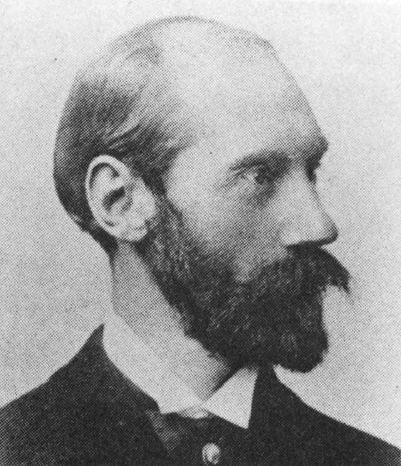
Electro-optic (Pockels) coefficient
Dielectric constant in the presence of effective field
Introduce tensor of electro-optic (Pockels) coefficients
1865–1913
Average index
is a second-rank tensor (3×3 matrix)
First rank tensor (1×6 vector)
is a third-rank tensor (3×3×3 matrix)
Second rank tensor (3×6matrix)
Depending on the symmetry of a given crystal many of the matrix elements are either zero or equal to each other

Slide 10
Electro optic crystals

Slide 11
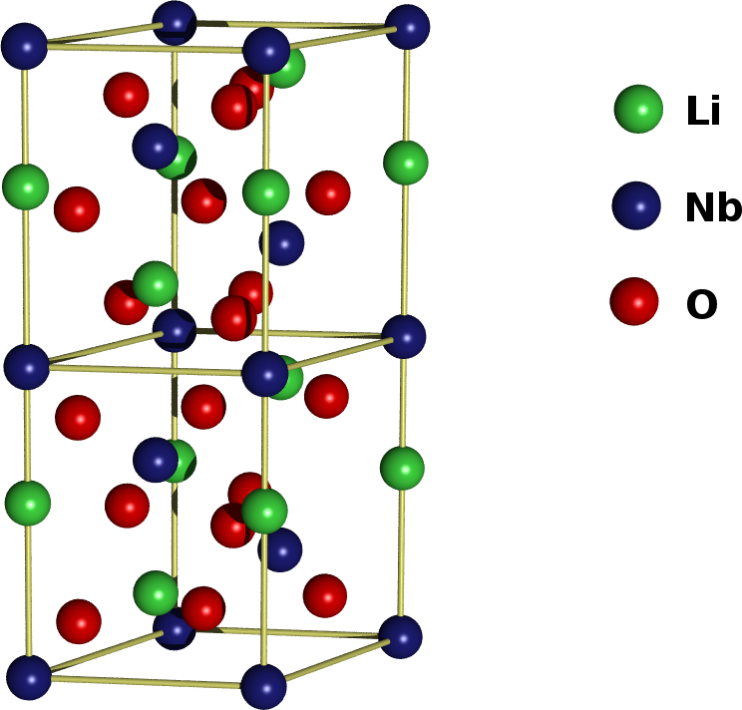
Ionic contribution to EO effect
Consider LiNbO₃
This is way too much considering that only a few electronic bonds are actually non-centro-symmetric. There must be another contribution – ionic
a_{b}
-
+
-
+
When the electric field is applied, the bond length changes.
E
a_{b} +Δa_{b}
-
+
-
+
When bond length increases, the restoring force K in the Lorentz model decreases, hence the resonant frequency ω₀ also decreases and the optical permittivity and refractive index increase
The easier it is to move ions, the larger is the change. The measure of “easiness” of ion motion is ionic polarizability, i.e. static dielectric constant ε_{DC .} Therefore good electro-optic materials have all large static dielectric constant and are often ferroelectric. In some materials, like GaAs electronic and ionic contributions nearly cancel each other.

Slide 12
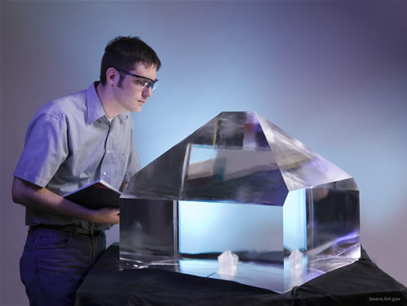
Electro-Optic Crystals
A very common kind of crystals KDP (KH₂PO₄), KD*P (KD₂PO₄), ADP (NH₄PO₄) They have just three non-zero electro-optic coefficients r₄₁=r₅₂ and r₆₃
Crystal | KDP | KD*P | ADP
r₄₁ (pm/V) | 8 | 9 | 23
r₆₃ (pm/V) | 10 | 27 | 8
KDP crystal at National Ignition Facility
In the absence of DC field crystals are uniaxial with impermeability tensor
Apply bias:
L
y
x
E_{DC}
z
V_{DC}
Usual ellipsoid equation

Slide 13
Index Ellipsoid in Electric Field
Crystal becomes biaxial
Rotate axes 45 degrees. In the new a,b coordinate system
y
b (f)
n_{s}
a (s)
n_{f}
x

Slide 14
Induced Birefringence
Jones Matrix in s-f coordinates
-half-wave voltage
For KD*P at λ=500nm Vπ=3.4kV
In x-y coordinates

Slide 15
Longitudinal Amplitude Modulation
Ein
E
Place the EO crystal between two crossed polarizers
In
EDC
L
Ex
Ey
If we come with the vertically -polarized light
V_{DC}
E
Out
Power:

Slide 16
Longitudinal Amplitude Switching and Modulation
S_{out}/S_{in}
S_{out}(t)
V_{DC}
V_{π}
2V_{π}
t
V_{SW}(t)
Switching works well but if we want to modulate with the small low frequency sine wave
t
Signal gets distorted (2nd harmonic) and the depth of modulation is small because we are operating on the quadratic rather than linear part of transfer charcateristcs

Slide 17
Linear Longitudinal Amplitude Modulation
Ein
E
Introduce additional λ/4 plate
In
EDC
L
Ex
Ey
45°
V_{DC}
s
f
λ/4
E
Out

Slide 18
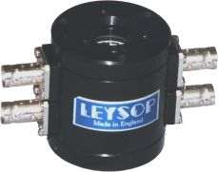
Linear modulation
S_{out}/S_{in}
S_{out}(t)
V_{IN}
V_{π}
2V_{π}
t
V_{IN}(t)
t

Slide 19


Transverse modulators
Ferroelectric crystals - perovskites - LiNbO₃, KNbO₃, LiTaO₃
Electro-optic tensor
EO coefficient (pm/V) | LiNbO₃ | LiTaO₃
r₁₃ | 9.6 | 8.4
r₂₂ | 6.8 | -0.2
r₃₃ | 31 | 30.5
r₅₁ | 32 | 15
c
C-optical axis
c
+45°
VDC
-45°
d
LiNbO₃ compensator
Out
In
z
L
To compensate for natural birefringence
y
x

Slide 20
Transverse EO modulator
compensator
For LiNbO₃, at λ=500nm, d=0.25mm, L=10mm, Vπ=64V , but the aperture is small

Slide 21
Transit time limitation
Let us see how can we modulate light of optical frequency ω with RF frequency Ω<< ω
v_{g}
d
Since index of refraction is time dependent the light encounters different indices as it propagates. Output phase for each polarization is
z
L
The phase difference is
transit time
therefore
All time-independent terms
Modulation response
3dB bandwidth

Slide 22
Traveling wave modulator-velocity matching
The problem with lumped modulator is that as light propagates it sees the change of sign of the field when i.e when
where is a period of RF and the modulation gets cancelled completely when
v_{RF}
Consider a traveling RF wave launched along a stripline transmission line (waveguide)
v_{g}
d
is a position of photon)
z
L
Voltage seen by the photon
3dB bandwidth
The closer are the two velocities the larger is the bandwidth –when two velocities are equal the propagating light sees the same field through the entire length of the modulator
Matching velocities is a difficult task

